Slide 1
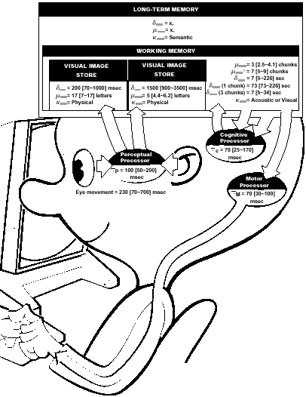
The User Human Information Processing Systems and User Profile
Human-Computer Interaction Beatriz Sousa Santos 2026

Slide 2

Interactive systems are meant to be used by people: the users and must be designed considering their characteristics

Slide 3
Outline
Users Profile – relevant characteristics for interactive systems design
Human Information Processing System (HIPS)
Perceptual sub system
Senses
Sight, Hearing, Touch, Smell, Taste
+ Proprioception, Kinesthesia …
Cognitive sub-system
Memory
Other relevant characteristics
Implications on the design of interactive systems

Slide 4




Dialog in an interactive system
respond read-scan
Perceptual sub-system
interface
user
think
Cognitive sub-system
think
computer
read-scan respond
Motor sub-system

Slide 5
User profile
- Human Information Processing System (HIPS)
- Knowledge and experience
- Work and task
- Physical characteristics
- Environment/context
More variable among users
There are many user models to be used in the design of Interactive systems
(e.g. personas, GOMS, KLM, …)

Slide 6

Human senses and cognition have characteristics that determine or limit what we can perceive and process
Vanseo Design

Slide 7
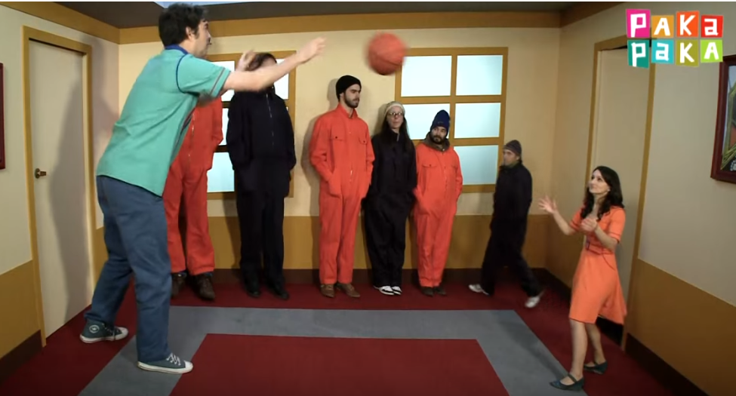
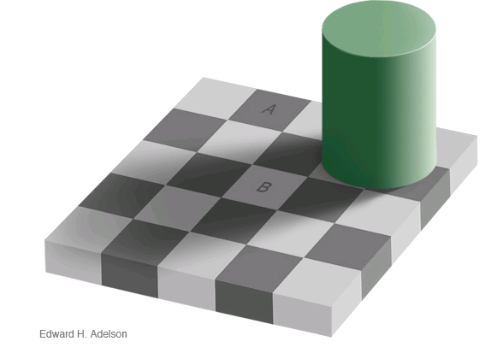

What we see does not depend only of the stimuli!
Two very powerful visual illusions:
The Ames’ room The Adelson´s illusion
https://michaelbach.de/ot/lum-adelsonCheckShadow/index.html
https://www.youtube.com/shorts/IP-okkvbvwg
Notes:
https://www.youtube.com/watch?v=aS-vzPuZzuk
When interpreted as a 3-dimensional scene, our visual system immediately estimates a lighting vector and uses this to judge the property of the material.
This beautiful demonstration was published by Ted Adelson 1995, the original figure is found here, his explanation here.

Slide 8
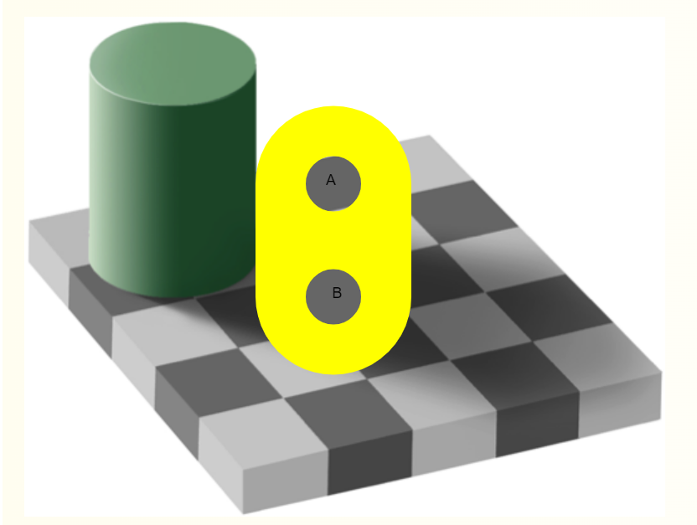
What we see does not depend only of the stimuli!
Two very powerful visual illusions:
The Ames’ room The Adelson´s illusion
https://michaelbach.de/ot/lum-adelsonCheckShadow/index.html
https://www.youtube.com/watch?v=-IWk5NkxQF8&t=33s
Notes:
When interpreted as a 3-dimensional scene, our visual system immediately estimates a lighting vector and uses this to judge the property of the material.
This beautiful demonstration was published by Ted Adelson 1995, the original figure is found here, his explanation here.

Slide 9
Human Information Processing System (HIPS)
Humans have different capabilities that might be considered when designing interactive systems
Information is received through various input channels (senses)
Information is stored in memory
Emotions may influence capabilities
Users share common characteristics but differences cannot be ignored

Slide 10
Human Information Processing System (HIPS): main aspects relevant to interactive systems design
Perceptual sub-system memory – perceptual buffer (iconic, echoic, …)
process – pattern recognition
short term/working memory (STM)
memory -
long term memory (LTM)
Cognitive sub-system
selective attention
processes - problem resolution learning
…
Motor sub-system
HIPS bottleneck

Slide 11
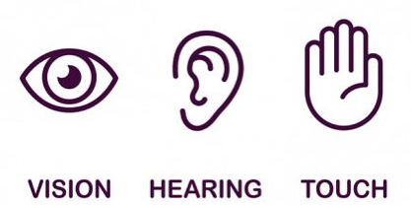
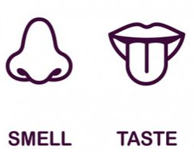
Perceptual sub-system – I/O
Input: 5+ senses
Sense is a physiological capacity
of organisms that provides data
for perception
Some more relevant than other
For HCI, vision is preferred,
but hearing and touch are more and more important …
Proprioception (more important in some types of systems: Virtual reality)
Output: communication system
vocal, gestures, eye gaze, ,…
The five Aristotelian senses
(but there are other…)

Slide 12
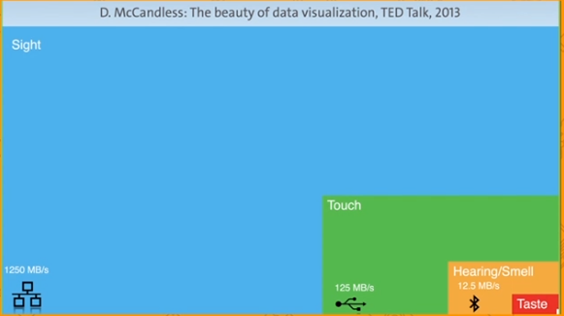
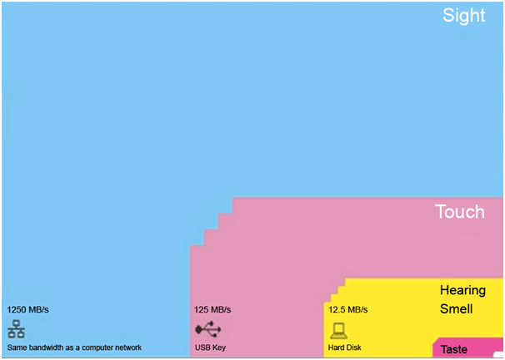
Why vision is preferred
Bandwidth of our senses proposed by Danish Physicist - Tor Nørretranders
we are aware of only 0.7%
of reality
Notes:
D. MaCandless: The beauty of data visualization TED Talk, 2013
FAST – Revisit later – Sight orders operates at faster orders of magnitude
If you compare sight with the next strongest sense touch, the processing speed of sight is 10 times faster.
Factoring in the mind’s ability to process visual information 60,000 times faster and with greater understanding than text, you get a mind and eye network that’s primed and ready for data visualization and infographics.

Slide 13
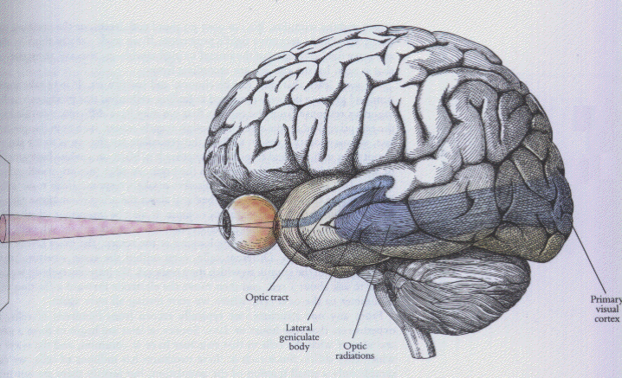
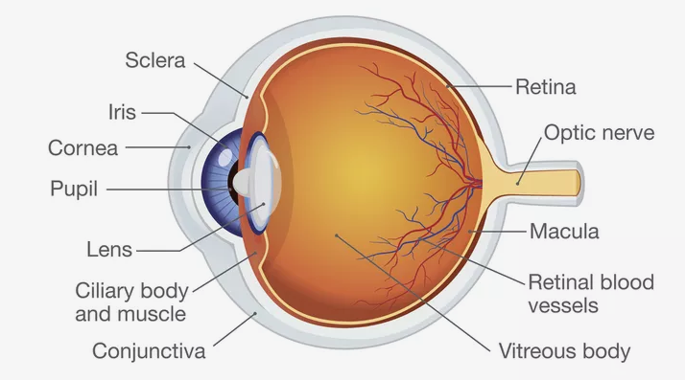
Vision
Relevant for HCI:
Color perception and peripheral vision
Compensation of movements and illumination changes
Context used to solve ambiguities
May be tricked: Visual illusions come from excessive compensation.
The sensor: eye
Eye – sensor
Brain - processor
(Hubel, 1988)

Slide 14
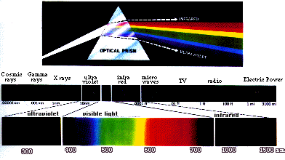
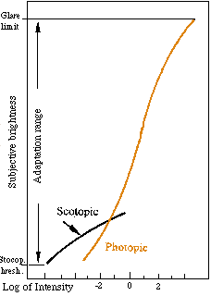
The Human Visual system is sensitive only to a small part of the electromagnetic spectrum
Two types of vision:
Scotopic – works at low illumination levels; not sensitive to wave length
Photopic – works at higher illumination levels; sensitive to wave length
-> color perception
(in low intensity light there is no color)

Slide 15
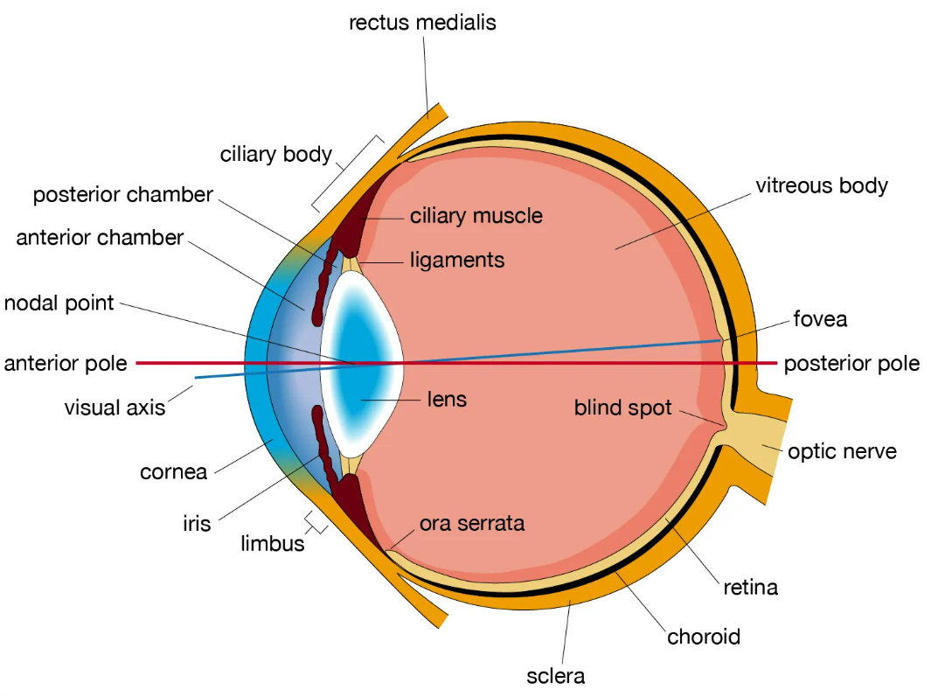
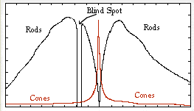
The light passes through the iris, is focused by the lens and projected on the retina
Two types of sensor cells:
Rods – scotopic vision
Cones – photopic vision
Some people have abnormal cones and do not see color as most people
Color vision is mostly in the center
Three types of cones:
Green - 64%
Red - 33%
Blue - 2% (less sensitive)
Human eye
n. sensors/mm²
Degrees from fovea

Slide 16
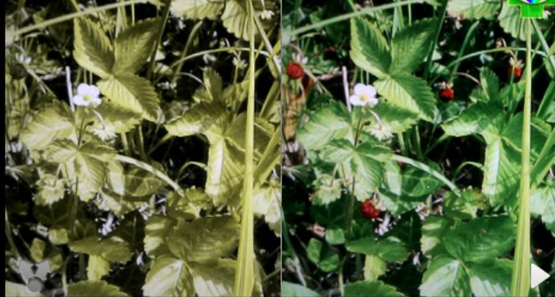
Colour blindness affects a significant percentage of users
daltonism-correction-daltonizer-app

Slide 17
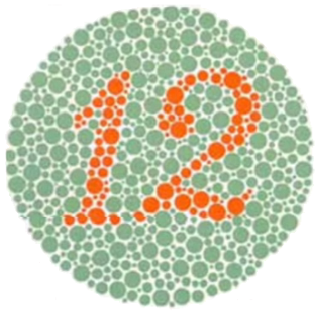
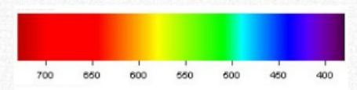
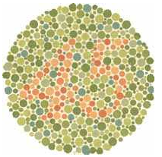
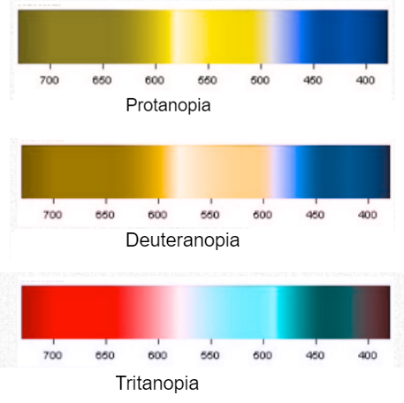
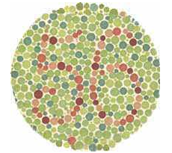
Color blindness Ishihara test for red-green blindness (daltonism or deuteranopia)
(Shinobu Ishihara,1917)
- The test includes 38 figures
Notes:
The Ishihara Color Test is a test for red-green color deficiencies. It was named after its designer, Dr. Shinobu Ishihara, a professor at the University of Tokyo, who first published his tests in 1917. [1]
The test consists of a number of colored plates, called Ishihara plates, each of which contain a circle of dots appearing randomized in color and size. Within the pattern are dots which form a number visible to those with normal color vision and invisible, or difficult to see, for those with a red-green color vision defect. The full test consists of 38 plates, but the existence of a deficiency is usually clear after a few plates. Testing the first 24 plates gives a more accurate diagnosis of the severity of the color vision defect.
Common plates include a circle of dots in shades of green and light blues with a figure differentiated in shades of brown, or a circle of dots in shades of red, orange and yellow with a figure in shades of green; the first testing for protanopia and the second for deuteranopia.

Slide 18
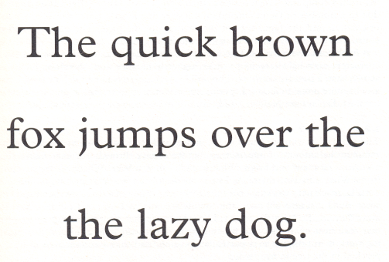

Pattern Recognition
Process that matches information from a stimulus with information retrieved from memory
- It is a very powerful process
- It is subconscious
- It does not use only current data
- It solves ambiguities
- Occurs also in other senses
(Kaniza illusion, Wikepedia)
Notes:
https://en.wikipedia.org/wiki/Pattern_recognition_(psychology)
In psychology and cognitive neuroscience, pattern recognition describes a cognitive process that matches information from a stimulus with information retrieved from memory.[1] Among others, the recognized patterns can be those perceived in facial features,[2] units of music,[3] components of language[4] or characters and other symbols.[1] One theory understands patterns as a set of characteristic features extracted from the stimulus, but it does not comprehensively describe the process or the role of context and there is a multitude of other theories with different approaches.[a] Pattern recognition does not occur instantly, although it does happen automatically and spontaneously.[citation needed] Pattern recognition is an innate ability of animals.

Slide 19
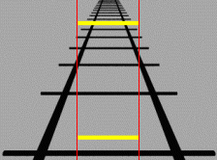
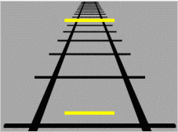
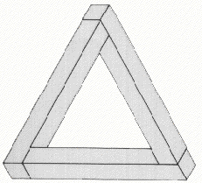

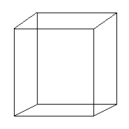
Visual Illusions illustrate that what we see does not depend only of the stimulus
bring out good adaptations of our visual system to standard viewing situations
under artificial manipulations can cause inappropriate interpretations of the scene
Ponzo illusion
Kanizsa illusion
Pennrose triangle:
Impossible object?
Necker cube
Notes:
The use of perceptual organization to create meaning out of stimuli is the principle behind other well-known illusions including impossible objects. Our brain makes sense of shapes and symbols putting them together like a jigsaw puzzle, formulating that which isn't there to that which is believable.

Slide 20
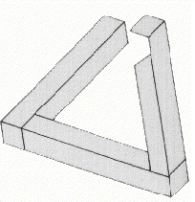
Visual Illusions illustrate that what we see does not depend only of the stimulus
bring out particular good adaptations of our visual system to standard viewing situations
under some artificial manipulations can cause inappropriate interpretations of the visual scene
Ponzo illusion
Kanizsa illusion
Pennrose triangle:
Impossible object?
Necker cube
Notes:
The use of perceptual organization to create meaning out of stimuli is the principle behind other well-known illusions including impossible objects. Our brain makes sense of shapes and symbols putting them together like a jigsaw puzzle, formulating that which isn't there to that which is believable.

Slide 21
Kanizsa illusion:
Although there are no actual triangles a sort of pattern recognition phenomenon is triggered and the image is interpreted as two overlapping triangles (simple explanation)
https://en.wikipedia.org/wiki/Illusory_contours
Necker cube:
Cube with no visual cues as to its orientation; it can be interpreted to have either the lower-left or the upper-right square as its front side
https://en.wikipedia.org/wiki/Necker_cube
Other Visual Illusions:
https://www.youtube.com/shorts/IP-okkvbvwg
Notes:
The use of perceptual organization to create meaning out of stimuli is the principle behind other well-known illusions including impossible objects. Our brain makes sense of shapes and symbols putting them together like a jigsaw puzzle, formulating that which isn't there to that which is believable.

Slide 22
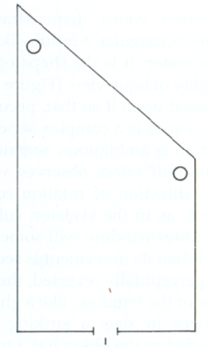
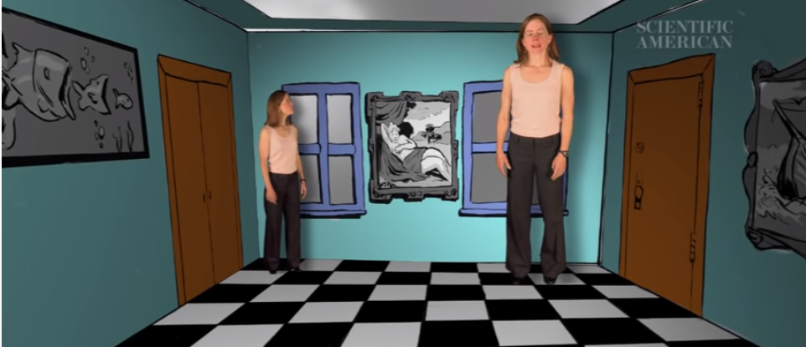
Ames Room
(what we see does not depend only of the stimulus)
A room that pushes the boundaries of human perception...
Point of view
https://www.youtube.com/watch?v=gJhyu6nlGt8

Slide 23
Pattern recognition
https://www.youtube.com/watch?v=VSp2Tm_M5ZQ
https://www.youtube.com/watch?v=zWvoPB-6Leg

Slide 24
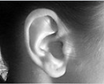
Other senses
Hearing
Information on direction, objects and distance
Only sense that is really 3D
Cannot be “turned off”
Human hearing - 20Hz to 15KHz
Filtering is possible (Background noise – “cocktail party” example)
https://en.wikipedia.org/wiki/Sense

Slide 25

Other senses
Touch
Important feedback
Key for people with sight problem
Several receptors in skin:
Termoreceptors: cold and hot
Nociceptor: pain
Mecanoreceptor: pressure
Some areas more sensitive (fingers)
https://en.wikipedia.org/wiki/Sense

Slide 26
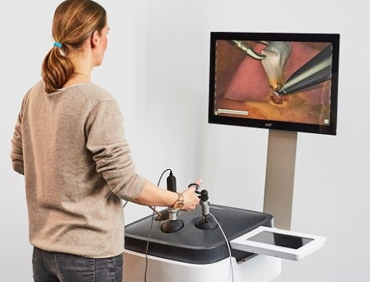
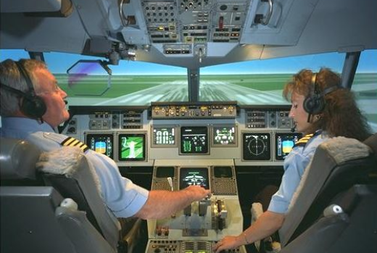
Simulators are complex interactive systems that stimulate several senses…
https://www.the737experience.co.uk/
https://surgicalscience.com/systems/lapsim/
https://en.wikipedia.org/wiki/Flight_simulator

Slide 27
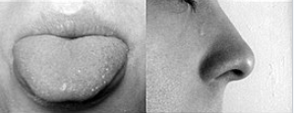
Other senses
Smell and Taste
Complex chemical senses
High latency
Difficult to use in HCI
Some experimental work exists (and some commercial products)
And others (as proprioception - awareness of your body position)
https://www.khanacademy.org/test-prep/mcat/processing-the-environment/somatosensation/v/proprioception-kinesthesia
https://neuro-marseille.org/en/blog/our-true-sixth-sense-on-arte/
https://en.wikipedia.org/wiki/Sense
Notes:
Kinesthesia is more behavioral

Slide 28
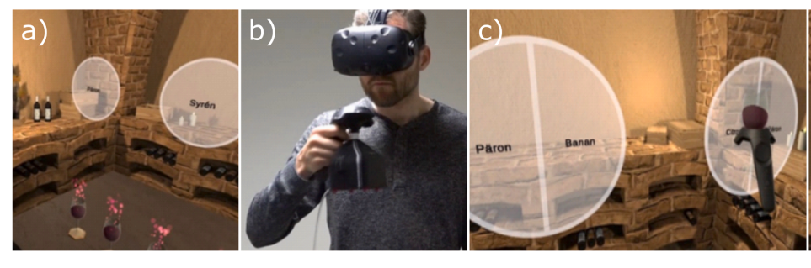
A virtual wine cellar game, with wine glasses to be grasped and sniffed
Simon Niedenthal, S et al., “A graspable olfactory display for virtual reality”, International Journal of Human-Computer Studies, vol. 169, 2023
https://doi.org/10.1016/j.ijhcs.2022.102928
Notes:
pressing the trigger button on the HTC Vive hand controller, the player releases wine bouquet from a virtual glass (b)

Slide 29
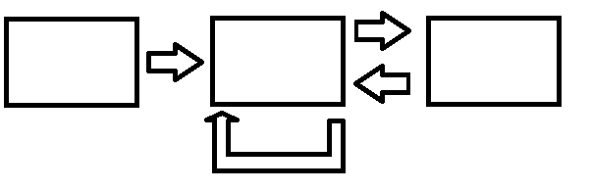
Memory
The Atkinson–Shiffrin model (1968) (a.k.a. multi-store model or modal model)
asserts that human memory has three components:
Sensory memory
Short-term memory -> working memory (more recent concept)
Long-term memory
Attention Transfer
Sensory
memory
STM
LTM
Retrieval
Rehearsal
https://en.wikipedia.org/wiki/Atkinson%E2%80%93Shiffrin_memory_model
Notes:
Wikipedia
The model asserts that human memory has three separate components:
a sensory register, where sensory information enters memory,
a short-term store, also called working memory or short-term memory, which receives and holds input from both the sensory register and the long-term store, and
a long-term store, where information which has been rehearsed (explained below) in the short-term store is held indefinitely.
Since its first publication this model has come under much scrutiny and has been criticized for various reasons (described below). However, it is notable for the significant influence it had in stimulating subsequent memory research.
https://en.wikipedia.org/wiki/Henry_Molaison

Slide 30
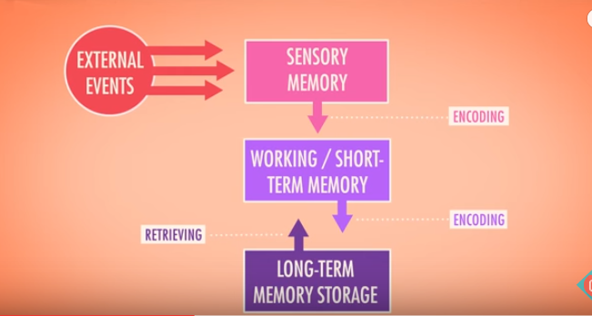
How we make memories - Crash Course Psychology #13
https://www.youtube.com/watch?v=bSycdIx-C48
How we remember and forget - Crash Course Psychology #14
https://www.youtube.com/watch?v=HVWbrNls-Kw

Slide 31
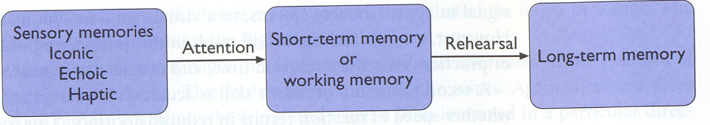
Memory
The Atkinson–Shiffrin model (1968) memory three components:
Sensory memory / iconic memory, very short
A few seconds
Short-term memory / working memory
+/- 18 seconds, 7+/-2 items
Long-term memory
~Infinite capacity

Slide 32
Short Term Memory (STM) / Working memory
Working memory:
Mental calculus (6*35)
Reading (understand a sentence)
…
Characteristics:
Quick access +/- 70ms
Quick forget
Limited capacity 7 +/- 2
Can be increased with chunking, to enter long-term memory
Notes:
Quick acess +/- 70ms
Quick forget +/- 200ms

Slide 33
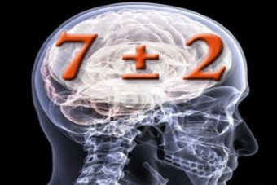
Short Term Memory (STM) / Working memory
a few characteristics:
Short duration: a few seconds (<30s)
Limited capacity: 7+2 elements
what is an element?
example: try to memorize the following numbers 649325401741
111122223333
which is easier?
and this one: 351234370517 ?

Slide 34
Short Term/ working Memory (STM)
649325401741 12 digits
111122223333 3 digits and a rule
234370200 351 234 370 517
Portugal Aveiro University area IEETA building
These numbers correspond to different “chunks”
Chunk: the largest meaningful unit that a person recognizes; depends on the person knowledge

Slide 35
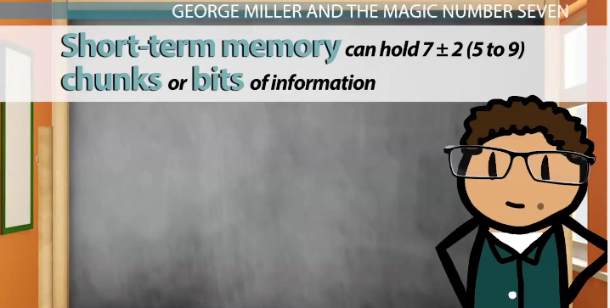
Chunking refers to an approach for making more efficient use of short-term memory by grouping information
Resulting chunks are easier to commit to memory than a longer uninterrupted string of information.
Can be used for making more efficient use of short-term memory by grouping information
http://study.com/academy/lesson/george-miller-psychologist-theories-on-short-term-memory-lesson-quiz.html
Notes:
https://en.wikipedia.org/wiki/Chunking_(psychology)
Chunking in psychology is a process by which individual pieces of information are bound together into a meaningful whole (Neath & Surprenant, 2003). A chunk is defined as a familiar collection of more elementary units that have been inter-associated and stored in memory repeatedly and act as a coherent, integrated group when retrieved (Tulving & Craik, 2000).
It is believed that individuals create higher order cognitive representations of the items on the list that are more easily remembered as a group than as individual items themselves. Representations of these groupings are highly subjective, as they depend critically on the individual's perception of the features of the items and the individual's semantic network. The size of the chunks generally ranges anywhere from two to six items, but differs based on language and culture
The phenomenon of chunking as a memory mechanism can be observed in the way individuals group numbers and information in the day-to-day life. For example, when recalling a number such as 12101946, if numbers are grouped as 12, 10 and 1946, a mnemonic is created for this number as a day, month and year. Similarly, another illustration of the limited capacity of working memory as suggested by George Miller can be seen from the following example: While recalling a mobile phone number such as 9849523450, we might break this into 98 495 234 50. Thus, instead of remembering 10 separate digits that is beyond the "seven plus-or-minus two" memory span, we are remembering four groups of numbers.

Slide 36
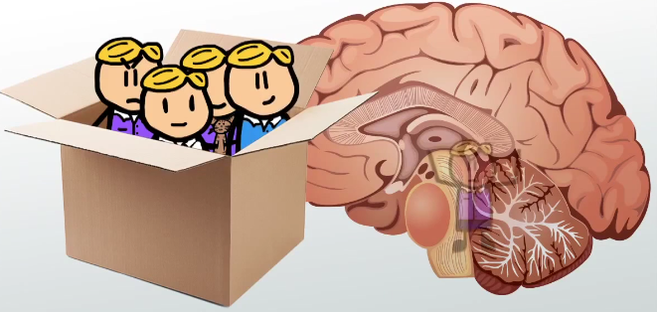
Long Term Memory
Stage of the dual memory model (Atkinson-Shiffrin memory model)
Informative knowledge can be stored for long periods of time
Main characteristics:
- “Infinite” capacity and duration
- non reliable access
http://study.com/academy/lesson/long-term-memory-definition-types-examples.html
Notes:
Fiquei aqui a 1/3/23
Long-term memory (LTM) is the stage of the dual memory model proposed by the Atkinson-Shiffrin memory model, and informative knowledge can be stored for long periods of time. While short-term and working memory persist for only about 18 to 30 seconds, informative knowledge can remain as long-term memory indefinitely.
Long-term memory is commonly labelled as explicit memory (declarative), as well as episodic memory, semantic memory, autobiographical memory, and implicit memory (procedural memory).
https://en.wikipedia.org/wiki/Intermediate-term_memory
Intermediate-term memory (ITM) is a stage of memory distinct from sensory memory, working memory/short-term memory, and long-term memory.[1][2] While sensory memory persists for several milliseconds, working memory persists for up to thirty seconds, and long-term memory persists from thirty minutes to the end of an individual's life, intermediate-term memory persists for about two to three hours.[3] This overlap in the durations of these memory processes indicates that they occur simultaneously, rather than sequentially. Indeed, intermediate-term facilitation can be produced in the absence of long-term facilitation.[4] However, the boundaries between these forms of memory are not clear-cut, and they can vary depending on the task.[5] Intermediate-term memory is thought to be supported by the parahippocampal cortex.[6]

Slide 37
Long-term Memory - Recognition vs. Recall
Information retrieval - Recognition vs. Recall
Recognition: remembering with the help of a visible cue
aka “Knowledge in the world”
Recall: remembering with no help
aka “Knowledge in the head”
Recognition is much easier
so e.g. menus are more learnable than command languages
Notes:
Fiquei - It’s important to make a distinction between recognition (remembering with the help of a visible cue) and recall (remembering something with no help from the outside world). Recognition is far, far easier than uncued recall.
Psychology experiments have shown that the human memory system is almost unbelievably good at recognition. In one study, people looked at 540 words for a brief time each, then took a test in which they had to determine which of a pair of words they had seen on that 540-word list. The result? 88% accuracy on average! Similarly, in a study with 612 short sentences, people achieved 89% correct recognition on average.
Note that since these recognition studies involve so many items, they are clearly going beyond working memory, despite the absence of elaborative rehearsal. Other studies have demonstrated that by extending the interval between the viewing and the testing. In one study, people looked briefly at 2,560 pictures, and then were tested a year later – and they were still 63% accurate in judging which of two pictures they had seen before, significantly better than chance. One more: people were asked to study an artificial language for 15 min, then tested on it two years later – and their performance in the test was better than chance.

Slide 38
Design Implications
Memory
Reduce cognitive load by avoiding long and complicated procedures for carrying out tasks.
Design interfaces that promote recognition rather than recall by using familiar interaction patterns, menus, icons, and consistently placed objects.
Provide users with a variety of ways of labeling digital information (e.g. files, emails, and images) to help them easily identify it again through the use of folders, categories, color, tagging, time stamping, and icons.

Slide 39
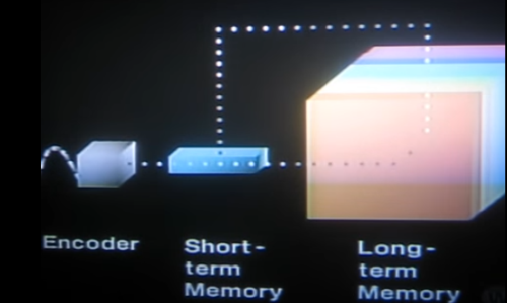
How We Make Memories - Crash Course Psychology #13
https://www.youtube.com/watch?v=bSycdIx-C48

Slide 40

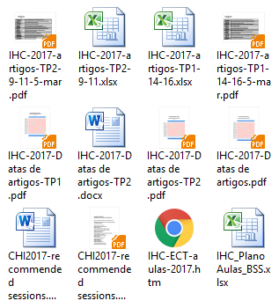
Selective attention
Occurs when we block out certain features of our environment
and focus on one particular feature
It may be:
- Voluntary
- Involuntary
Both can be (and are) exploited in UIs
Calling your attention to an application
https://dictionary.apa.org/selective-attention
https://www.khanacademy.org/test-prep/mcat/processing-the-environment/attention-language/v/selective-attention
Notes:
Fiquei aqui na TP1 28/2/24
http://study.com/academy/lesson/selective-attention-definition-examples-quiz.html

Slide 41
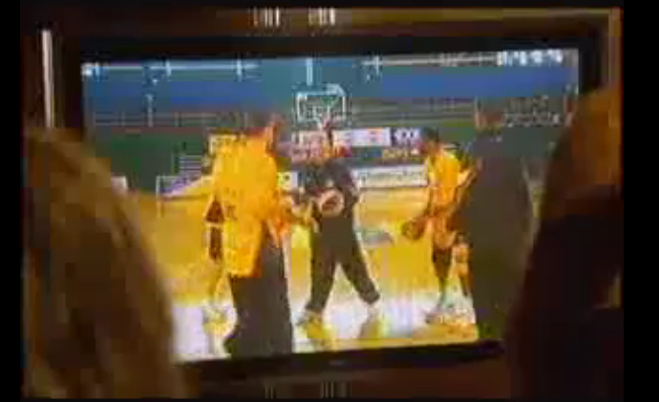
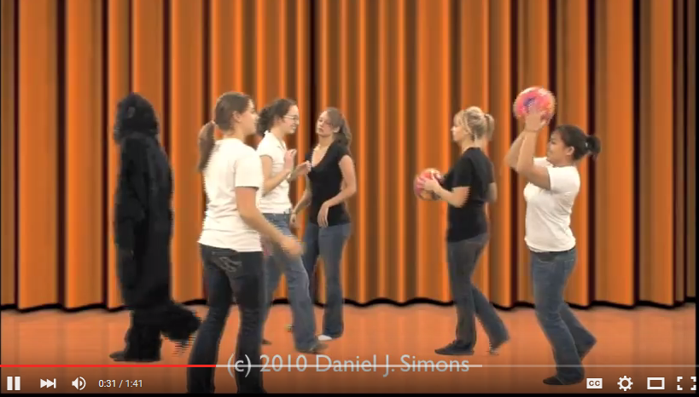
Inattentional blindness
Failure to notice an unexpected stimulus when other attention demanding tasks are being performed
What impact may it have on interactive systems design?
The relationship between
what is in the visual field
and perception depends
much on attention
https://www.youtube.com/watch?v=IGQmdoK_ZfY

Slide 42
Design Implications
Attention
Consider context. Make information salient when it requires attention at a given stage of a task.
Avoid cluttering visual interfaces with too much information.
Consider designing different ways of supporting effective switching and returning to a particular interface.

Slide 43
Design Implications
Learning
Design user interfaces that encourage exploration
Design user interfaces that constrain and guide users to select appropriate actions when initially learning.

Slide 44
Design Implications
Problem solving
Provide information and help that are easy to access for people who want to understand more about how to carry out an activity more effectively (e.g., web searching).
Use simple and memorable functions to support rapid decision-making and planning.
Enable users to set or save their own criteria or preferences

Slide 45
Emotion
Various theories on how it works
Involves cognitive and physical response to stimuli
Biological response to a physical stimuli is called affect
Affect Influences how we react to situations
“Negative affect can make it harder to do even easy tasks; positive affect can make it easier to do difficult tasks”
(Donald Norman)
Notes:
XR Education and Hybrid Horizons
XR Education and Hybrid Horizons

Slide 46
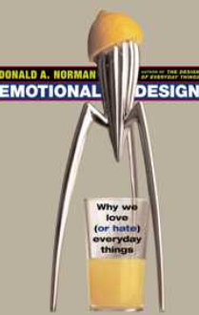
Not only the cognitive system is important
But also the emotional system
Emotional design is a critical part of design
Donald Norman videos:
User Centered Design Don Norman
Don Norman: The Design of Everyday Things
Notes:
http://www.interaction-design.org/tv/why_do_we_love_hate_everyday_things_don_norman.html
http://www.jnd.org/dn.mss/emotional_desig_1.html

Slide 47

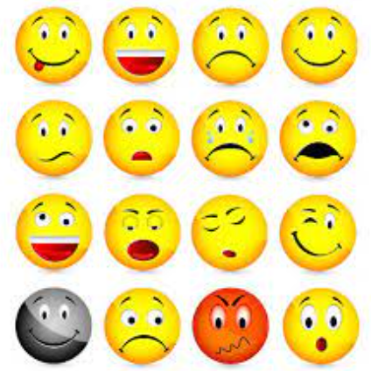
As … moved from designing and evaluating work-oriented applications towards dealing with leisure-oriented applications, … we have had to consider e.g. what constitutes an experience, how to deal with users’ emotions, and understanding aesthetic practices and experiences”
Affective Computing | The Encyclopedia of Human-Computer Interaction, 2nd Ed.

Slide 48
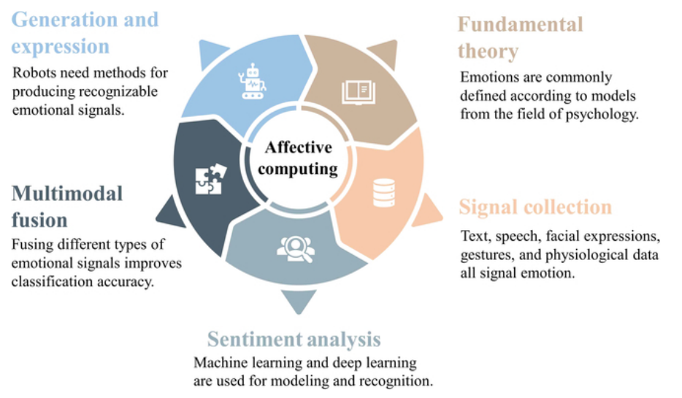
Affective computing is the study of how machines can recognize, interpret, and respond to human emotions. It's an interdisciplinary field that combines computer science, psychology, and cognitive science.
Affective Computing: Recent Advances, Challenges, and Future Trends | Intelligent Computing

Slide 49
Users have different abilities, contexts and motivations

Slide 50
We need to know who are the users, their characteristics, context, and what motivates them

Slide 51
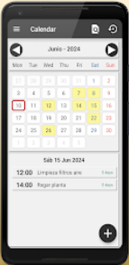


Is it the same to design a system to be used every day or once a year?

Slide 52


Is it the same to design a system for a doctor to use at their office
or at an Emergency Room?

Slide 53
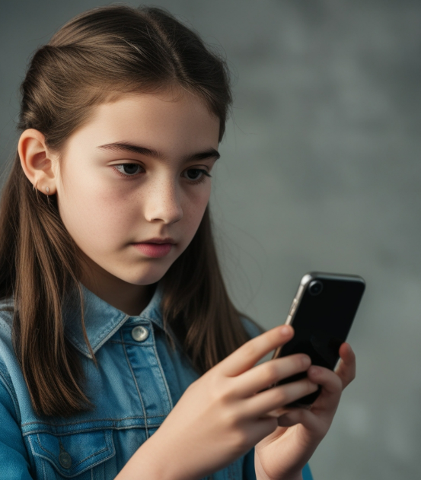


Is it the same to design a system for teenagers, adults or elderly users?
https://news.sky.com/story/alarming-study-reveals-everyday-tech-problems-facing-older-people-as-millions-dont-use-internet-at-all-12964823

Slide 54
User Profile- other characteristics (besides HIPS)
Experience and knowledge - education and reading level
experience with the system and task
mother language
computer literacy …
Work and task - usage frequency
training
usage type (mandatory, optional)
usage of other systems …
Physical Characteristics – color vision deficiencies
physical deficiencies
handedness
age …
Don’t forget cultural aspects!!…

Slide 55
User Profile - overview
Human Information Processing System
Experience and knowledge - education and reading level
experience with the system and task
mother language
computer literacy …
Work and task - usage frequency
training
usage type (mandatory, optional)
usage of other systems …
Physical Characteristics – color vision and physical disabilities
handedness
age …
Don’t forget Cultural aspects!!…

Slide 56
How do these characteristics influence UI design?
Much system experience, but low task experience -> more semantic help
Much task experience but low system experience -> more syntactic help
High usage frequency -> easy to use
Low usage frequency -> easy to learn and remember
Mandatory -> easy to use
Optional -> easy to learn and remember
Color (particularly red and green) should not be used as only cue to convey information
Etc., …

Slide 57





The take away:
- Users are much different from designers/developers
- Users vary a lot among thenselves
- Users change along time (evolve, forget...)
Final recommendations:
We should consider the users as an unknown
species and study them scientifically
Remember: You are not the user!

Slide 58
Main bibliography
Helen Sharp, Jenny Preece, Yvonne Rogers, Interaction Design – Beyond Human-Computer Interaction, 6th edition, John Wiley, 2023
http://www.id-book.com/chapter3_teaching.php
John Carroll, Human Computer Interaction - brief intro, The Encyclopedia of Human-Computer Interaction, 2nd edition https://www.interaction-design.org/literature/book/the-encyclopedia-of-human-computer-interaction-2nd-ed/affective-computing
Alan Dix, Janet Finlay, Gregory Abowd, Russell Beale, Human-Computer Interaction, 3rd edition, Prentice Hall, 2004
Thanks to leonardo.ai

Slide 59
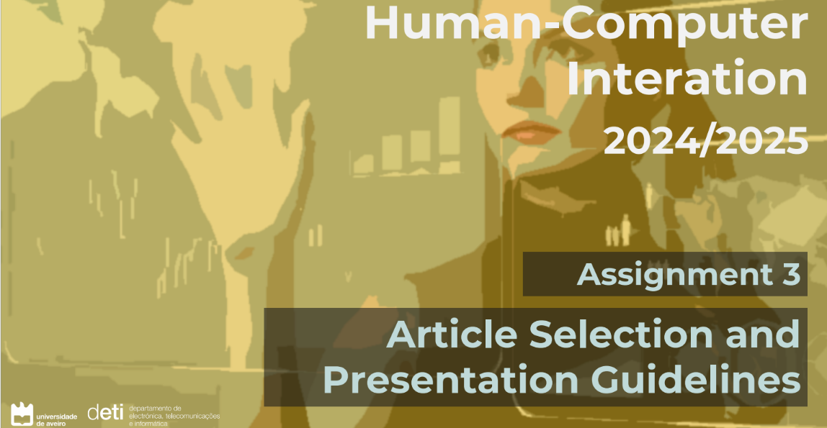
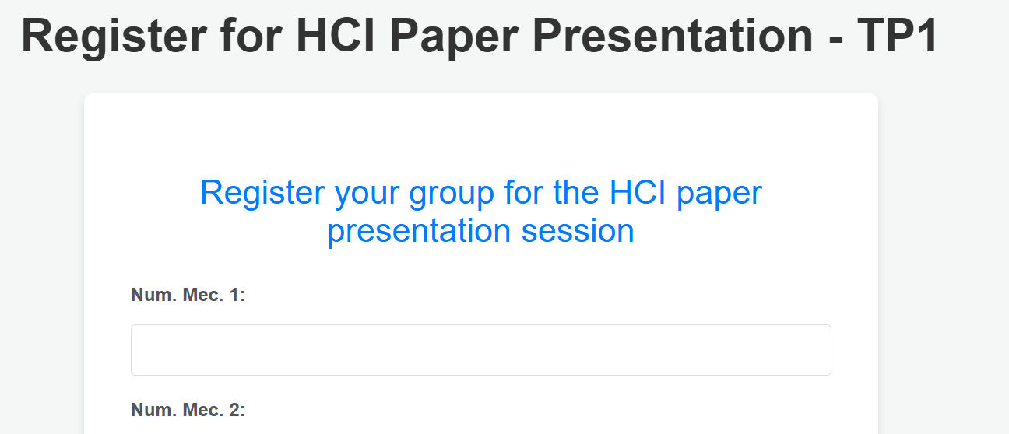
You may register your preferences
For TP1: https://hci.shire.camdvr.org/register/TP1
For TP2: https://hci.shire.camdvr.org/register/TP2
For TP3: https://hci.shire.camdvr.org/register/TP3

Slide 60

Signing in for Tutorial Sessions
It is possible to attend the weekly tutorial guidance sessions. It is on Thursdays, at 19h00, online.
These sessions will only occur if someone signs in for them in advance
If you wish to attend the week’s tutorial guidance session:
Go into the course’s Teams group
Enter the channel OTs
Vote YES on the corresponding Poll
Signing in needs to occur until 12h of the day of the session.
Example: if the session is at 19h of February, 13th, you need to sing in until 12h of that day

Slide 61


Paper Presentation Assessment
Students attending the presentation may vote via a link available in Moodle
Using the following scale:
5- Excellent
4- Very good
3- Good
2- Sufficient
1- Poor
Taking into consideration:
Adequacy
Slides
Presentation
Discussion
Exceeded time?

Slide 62
Paper presentation evaluation and voting
Consider the following aspects + presentation duration:
- Selection of the paper:
- is the topic understandable by this audience?
- Slides:
- are well organized?
- include the needed information?
- have the right amount of text and figures?
- Oral presentation:
- was fluid and enthusiastic/motivating?
- was balanced between the two presenters?
- Personal conclusions and discussion:
- the personal conclusions were adequate
- the presenters provided good answers
-
-

Slide 63


Paper presentation evaluation and voting
Voting scale on overall performance:
5- Excellent
4- Very good
3- Good
2- Fair
1- Poor

Slide 64

Presenters, please submit the slides via Moodle:

Slide 65

Have you selected the paper?
A suggestion:
https://ieeexplore.ieee.org/document/9915009

Slide 66



Selecting a paper:
Or from one of these smaller conferences
https://www.mum-conf.org/2022/schedule/#s2
(long papers available in Moodle)
https://sui.acm.org/2022/
Papers available from:
https://sui.acm.org/2022/program

Slide 67


